Slide 1

Welcome
MVUSD’s
Delac Meeting
11-17-21
Jill Buschhausen
jbuschhausen@murrieta.k12.ca.us

Slide 2
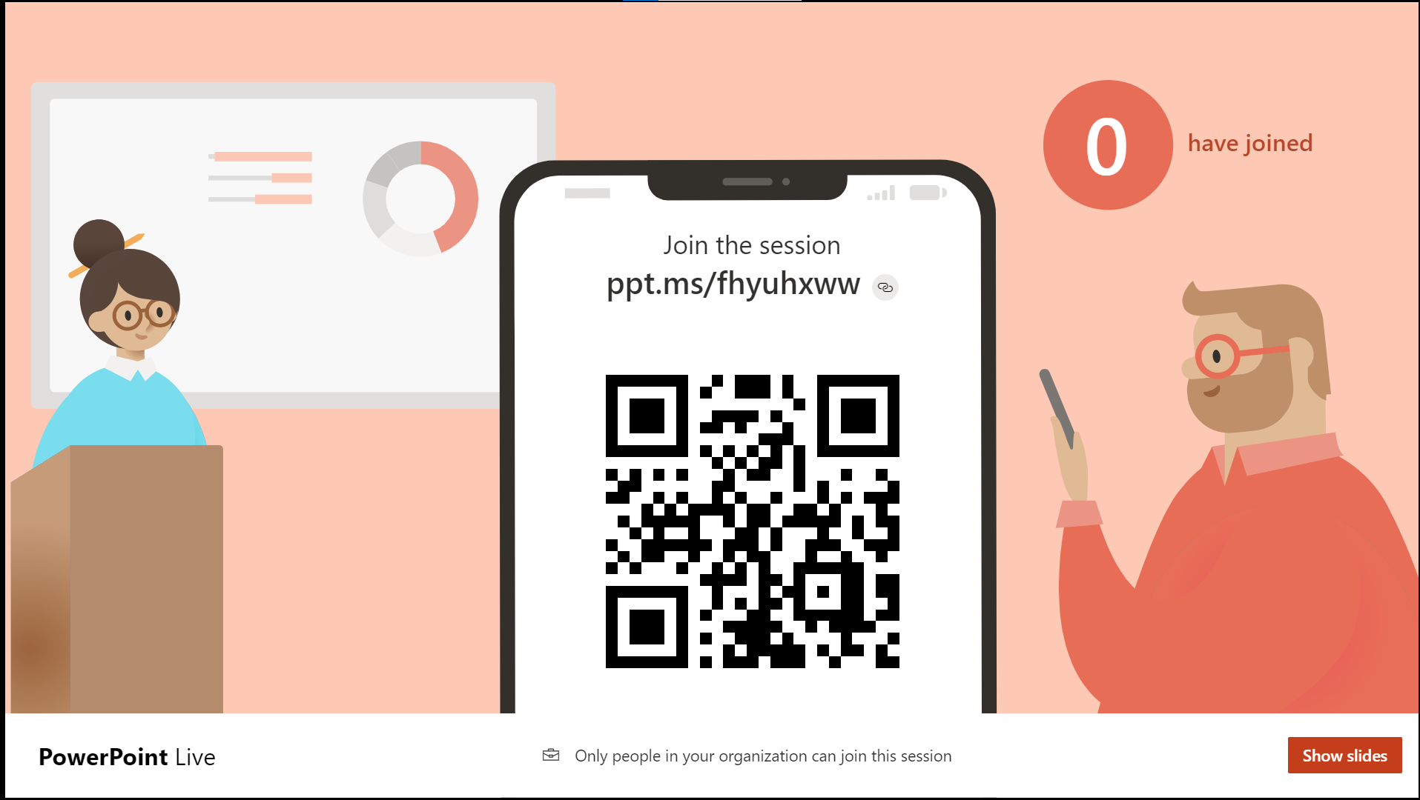
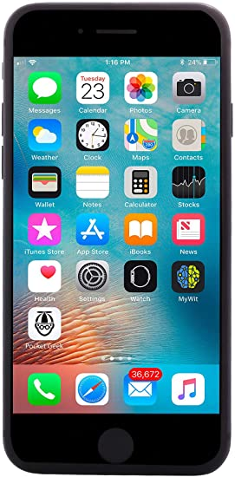
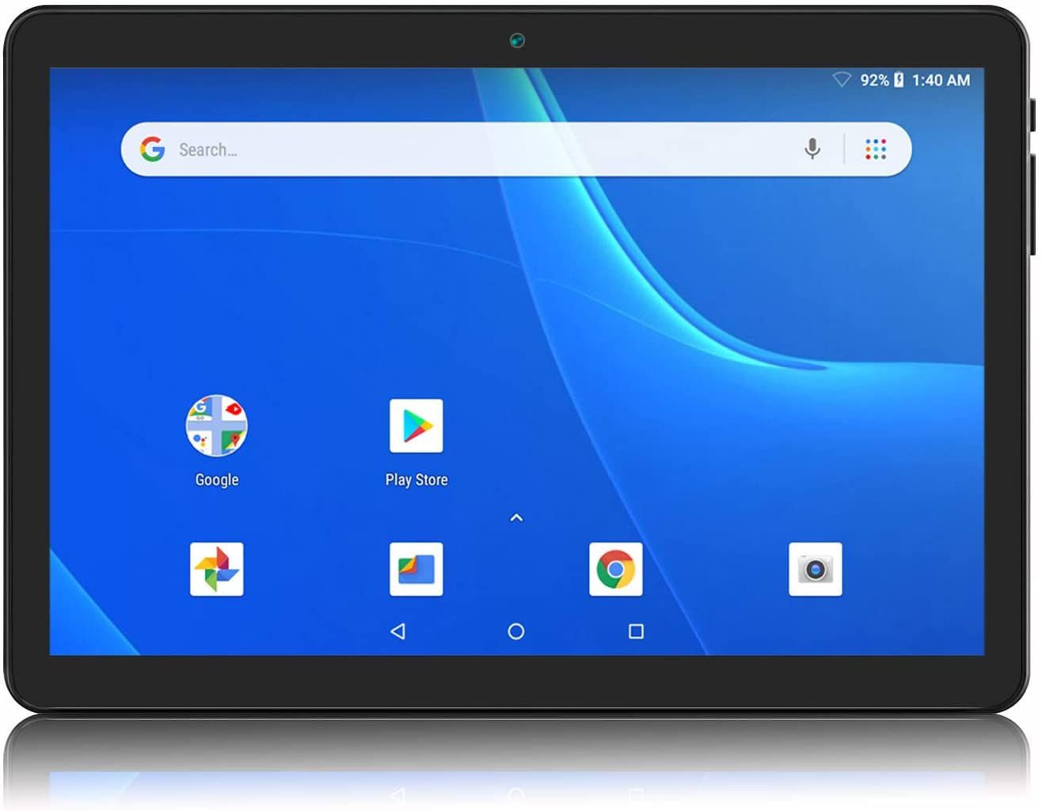
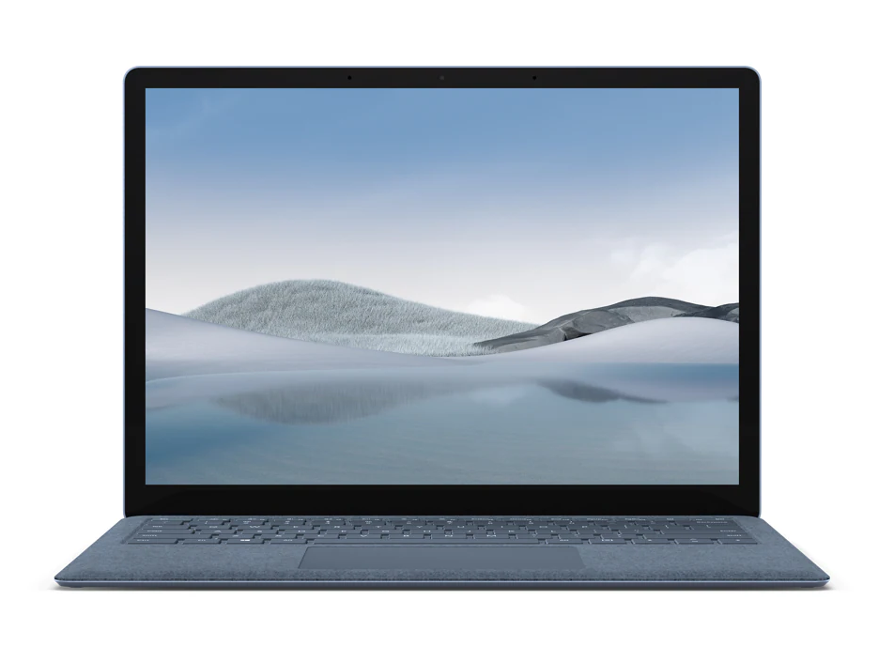
URL Address
QR Code
If you need audio translation, on the next screen scan the QR code or enter the URL address into a web browser
Kung kailangan mo ng audio pagsasalin, sa susunod na screen i-scan ang QR code o ipasok ang URL address sa web browser
Si necesita traducción de audio, en la siguiente pantalla escanee el código QR o ingrese la dirección URL en un navegador web
Nếu bạn cần dịch âm thanh, trên màn hình tiếp theo quét mã QR hoặc nhập địa chỉ URL vào trình duyệt web
如果您需要音频翻译，请在下一个屏幕上扫描 QR 代码或将 URL 地址输入 Web 浏览器
إذا كنت بحاجة إلى ترجمة صوتية، قم على الشاشة التالية بمسح رمز الاستجابة السريعة أو أدخل عنوان URL في مستعرض ويب

Slide 3
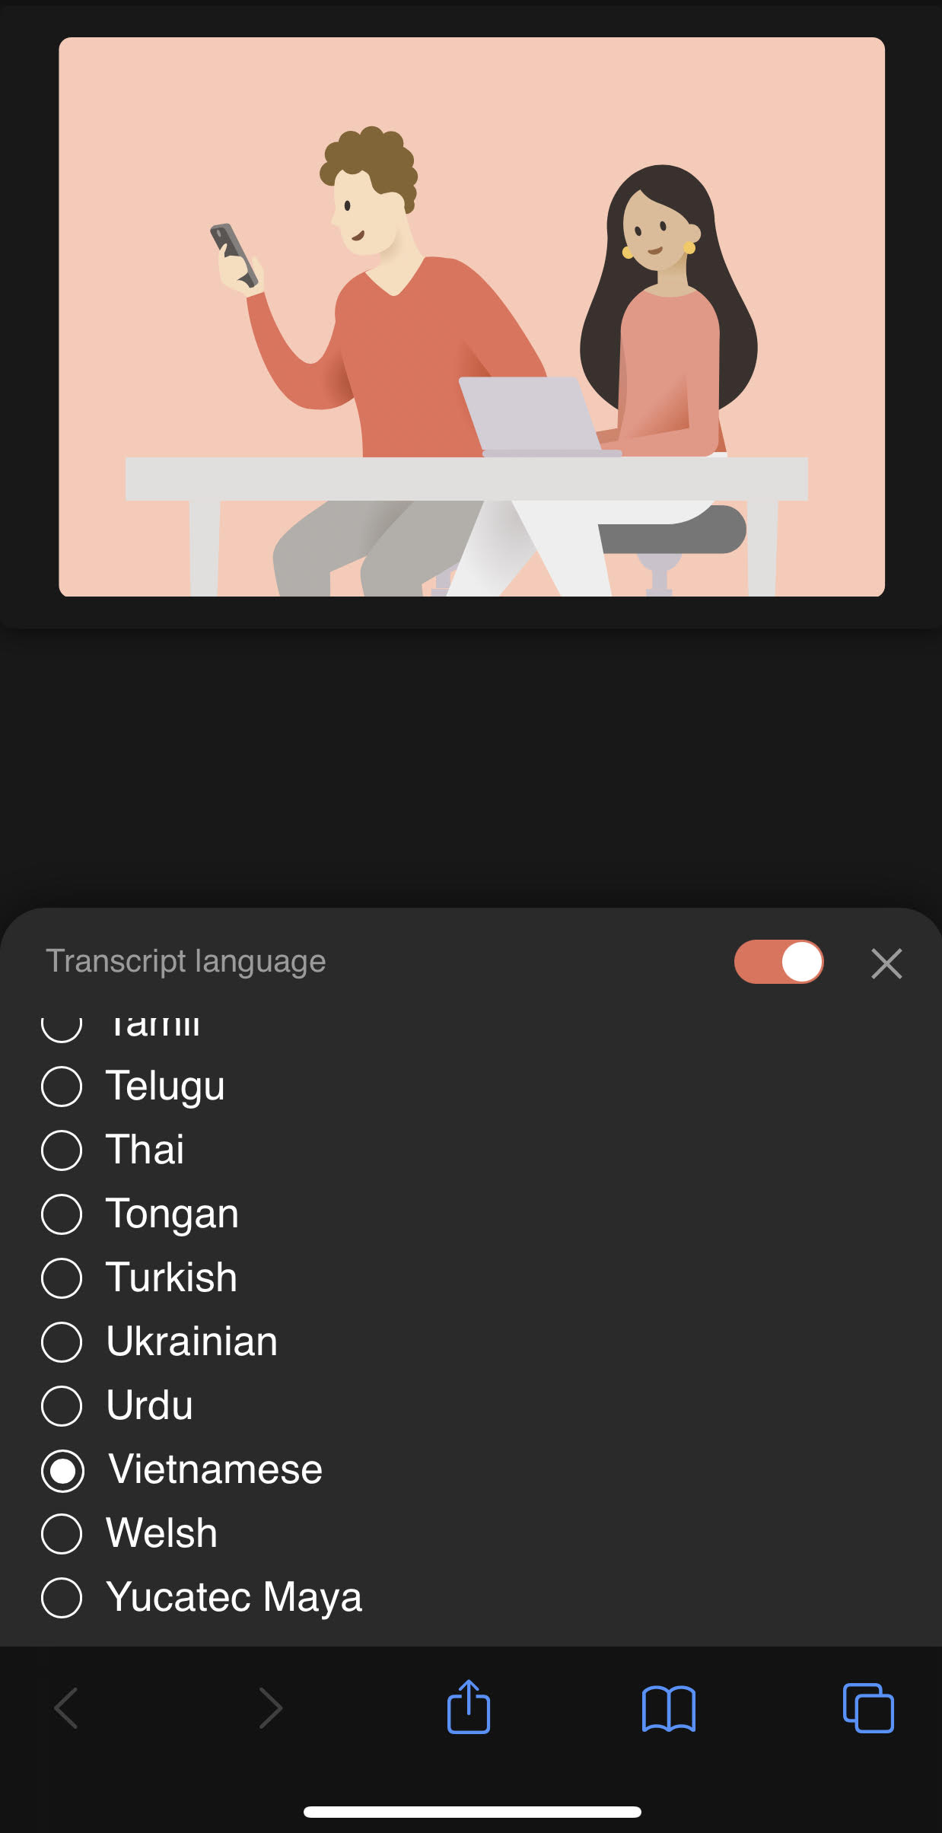
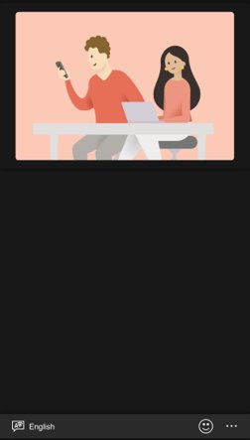
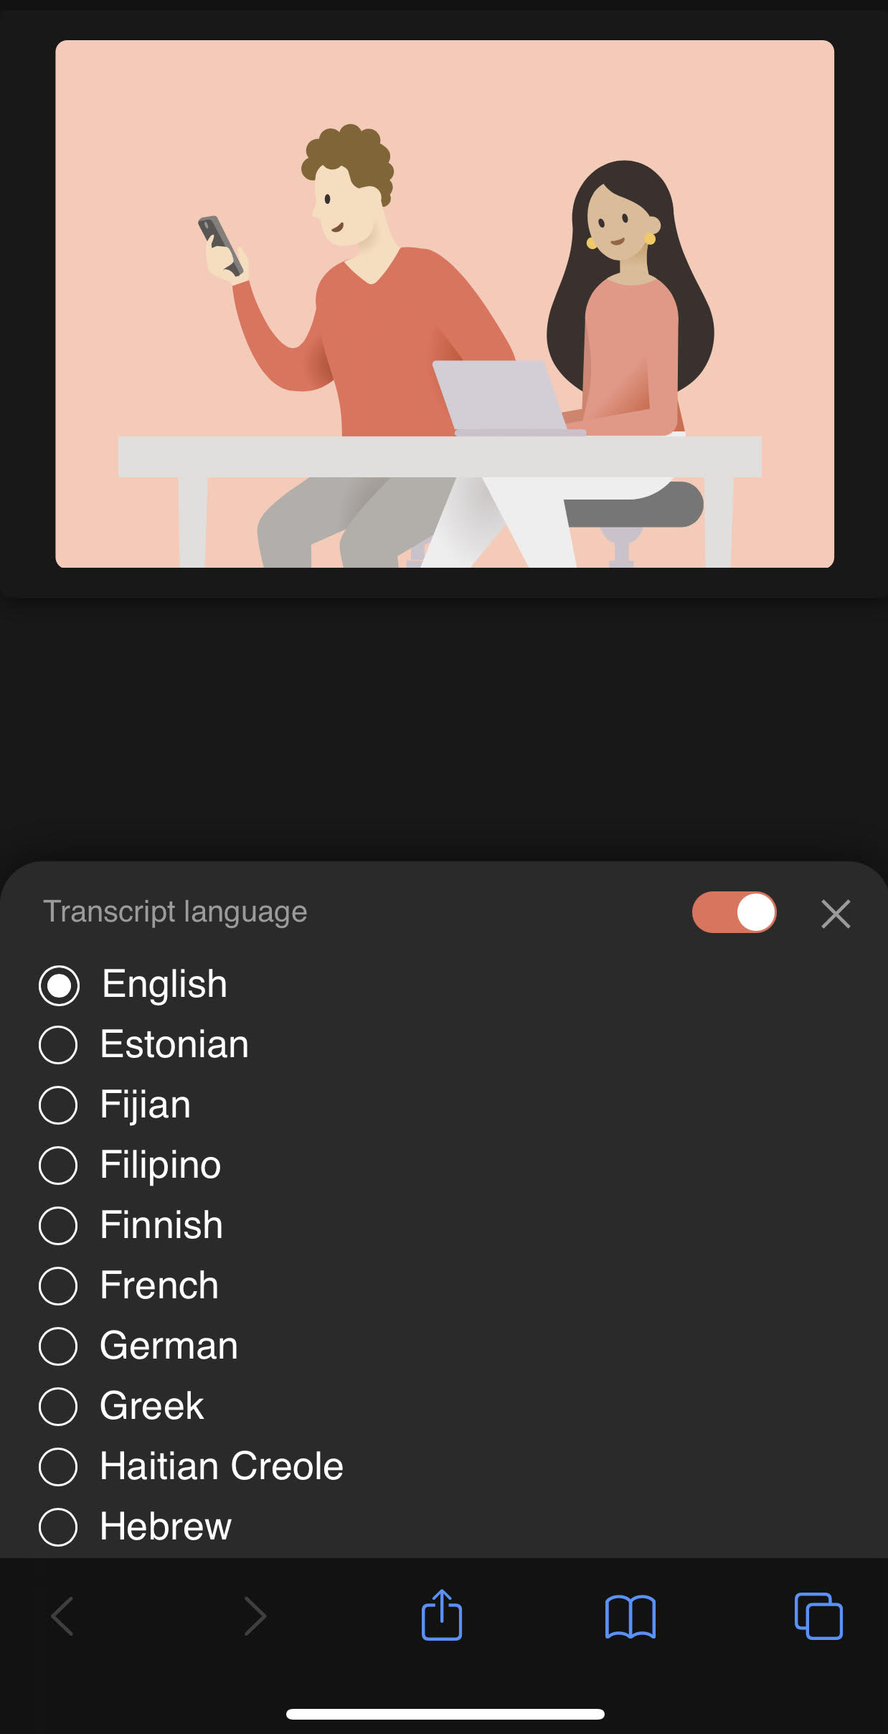
Choose your preferred language from the list
从列表中选择您最喜爱的语言
Elija su idioma preferido de la lista
Chọn ngôn ngữ ưa thích của bạn từ danh sách
Piliin ang iyong ginustong wika mula sa listahan
اختر لغتك المفضلة من القائمة
Notes:
Coose your preferred language from the list

Slide 4
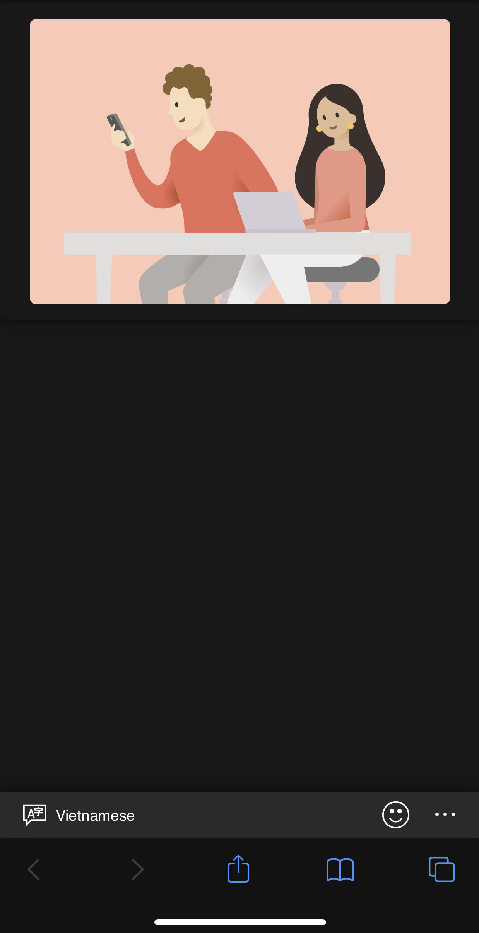
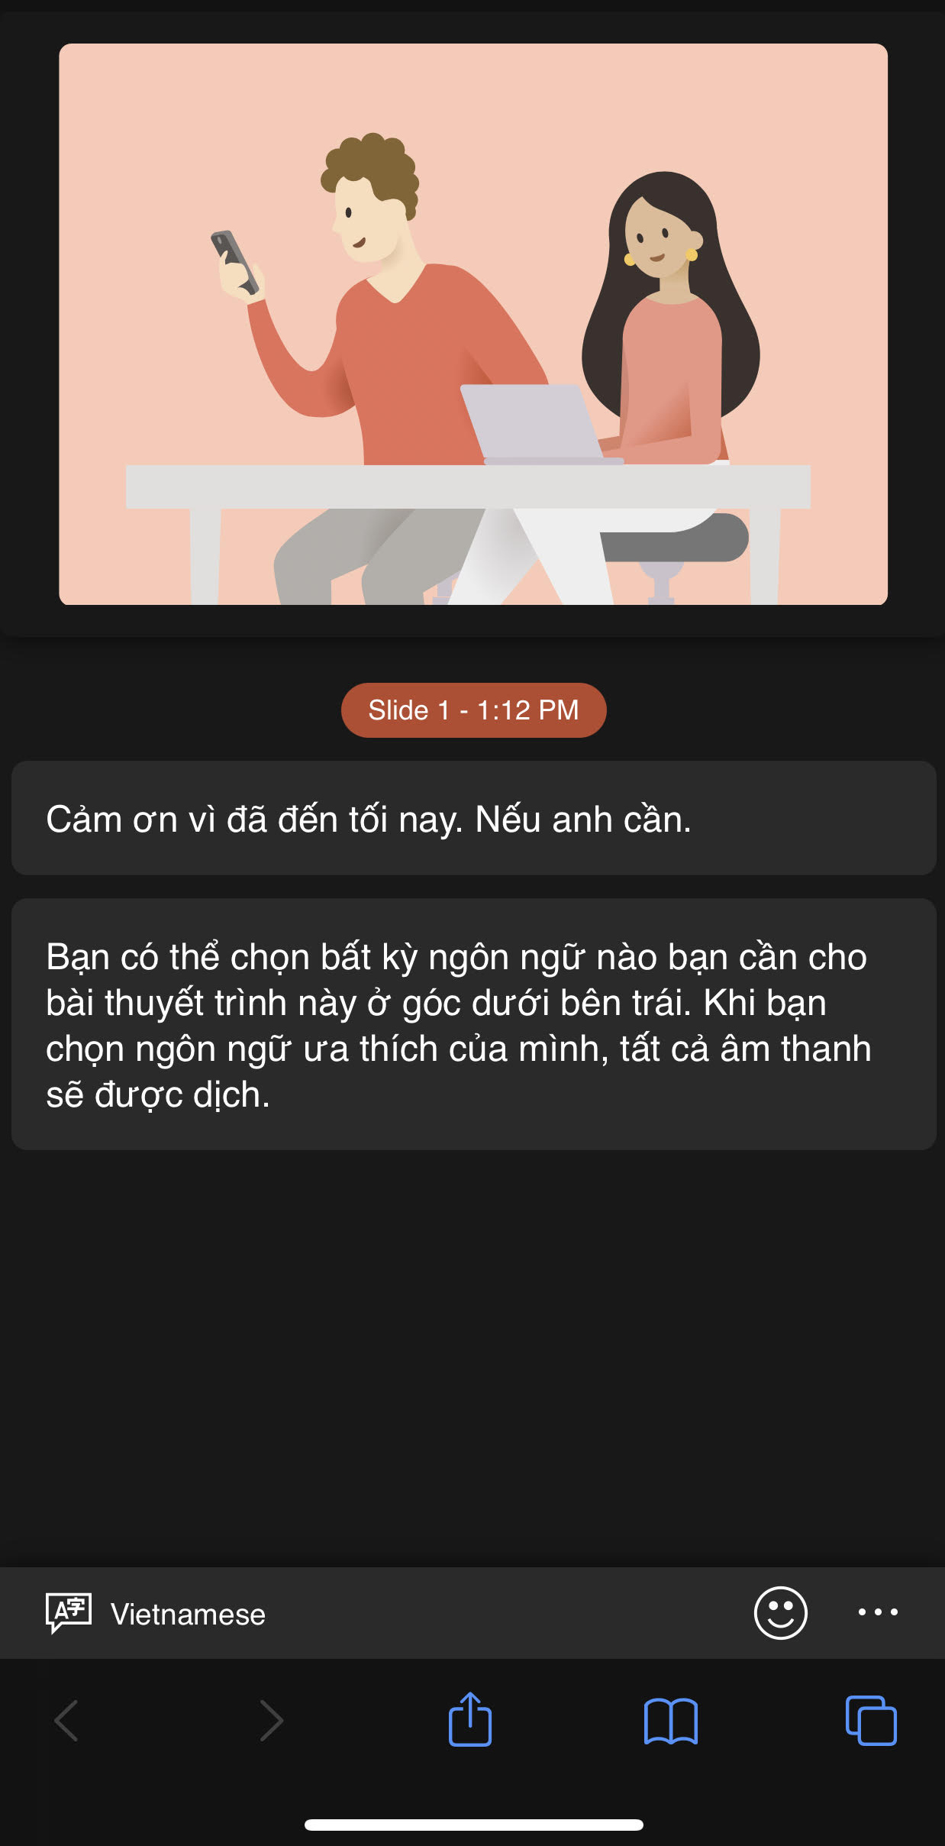
Your chosen language will be displayed in the lower corner. All audio will be automatically translated for you on your device.
El idioma elegido se mostrará en la esquina inferior izquierda. Todo lo dicho se traducirá automáticamente para usted en su dispositivo.
您选择的语言将显示在下角。所有音频将在您的设备上自动为您翻译。
Ang pinili mong wika ay ididispley sa mas mababang sulok. Lahat ng audio ay awtomatikong isasalin para sa iyo sa iyong device.
Ngôn ngữ bạn chọn dưới đây sẽ hiển thị góc dưới bên trái. Tất cả những gì đã nói sẽ được tự động dịch cho bạn trên thiết bị của bạn.
سيتم عرض اللغة التي اخترتها في الزاوية السفلى. سيتم ترجمة جميع الأصوات تلقائيا لك على جهازك.
Notes:
The language you chose will show in the bottom left corner. Everything that is said will be translated automatically on your device.

Slide 5
Welcome to 2021-22 ​
DELAC​
November 17, 2021​
5:00-6:00
Agenda
Microsoft Translate
Stakeholder Feedback
  Answering your needs
    Homework Support
    Transportation
    Extended aide hours
Reclassification​
  Criteria
  MVUSD Reclassification Data
  Reclassification Ceremonies
    Murrieta Elementary
    E. Hale Curran
  Parent Group Opt In Form
Next Meeting February 9

Slide 6
Responses from our Stakeholder Feedback
I’m happy to hear we have grants to help with tutoring- has the after-school tutoring program begun?
"Increased learning opportunities to remediate learning loss from school closures."
"Additional aides as well as additional hours for aides to stay with students longer."
"I think students just need to know that they have the support of the staff and also when we are struggling with their class, and they are aware we aren’t understanding the information, it would benefit us if they advertised solutions to help us with that class."
"More before/after school tutoring opportunities for elementary students."
"Presenting more opportunities for students to receive academic tutoring. Elementary parents are looking for any extra support for their children."
"Reading and Writing support in school because families don't feel confident helping their children with this at home."
"More supports during the week to help with assignment completion. Teacher expectation is to turn in a week's worth of work on Friday but if student doesn't understand due to language they are getting marked down for incomplete work and don't have an opportunity to get help with assignment before due date."
"Transportation for after school and after tutoring and Saturday school has been very helpful."

Slide 7
Answering your Needs
Elementary and Middle Schools
EL Homework Support before and after school at every site.
Tutoring and Homework Support offered for all students.
High Schools
EL Homework Support before and after school at every site.
Tutoring and Homework Support offered for all students.
Increased Bilingual Aide hours to 6.5 hours a day.
Transportation provided at Vista Murrieta for after-school homework support.

Slide 8
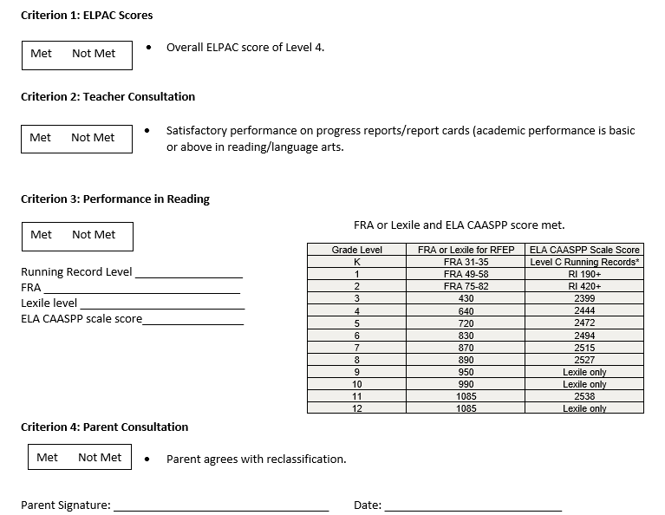
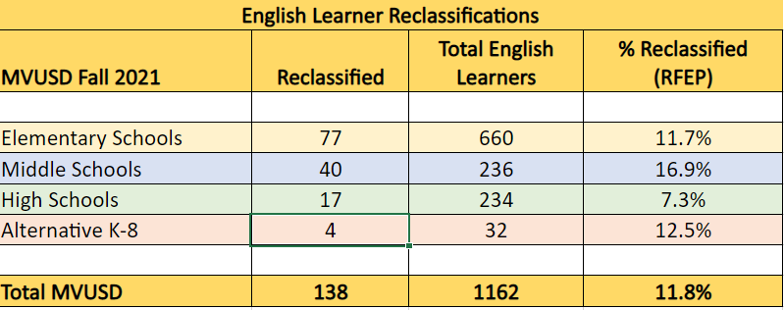
Our Goal for ALL our English Learners
Reclassification
Murrieta Elementary held a Reclassification Ceremony at their ELAC meeting on November 4th .
E. Hale Curran will celebrate their Reclassified students on Thursday, November 18th .

Slide 9
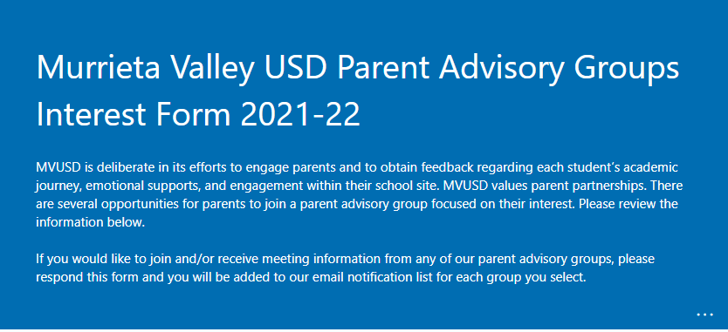
Parent Group Opt-in form

Slide 10

We are Thankful and Grateful for our English Learners and their Families

